Slide 1
The Effects of Foreign Direct Investment on the Growth Rate of High-Income Countries in the 21st Century
Chris Hayduk

Slide 2
Defining Terms
Growth rate of High-Income Countries
Will use time series data of GDP per capita to measure this
GDP - “the monetary value of all the finished goods and services produced within a country's borders in a specific time period.” (Investopedia)
Foreign Direct Investment - an investment made by a firm or individual in one country into business interests located in another country (“Investopedia”)

Slide 3
Hypothesis
Most research done on low-income countries
Increased FDI leads to improved technology and business practices
What about countries that are already leaders in technology and business?
Limit scope of study to high-income countries
Using G7 as a proxy for this: USA, UK, Italy, Germany, France, Japan, Canada
Hypothesis: Foreign Direct Investment will have little to no effect on GDP per capita in high-income countries due to the already highly-developed technology and business infrastructure

Slide 4
Data
Data sources
World Bank Open Data
OECD Data
Response variable
GDP per capita
Predictors
Foreign Direct Investment as a percentage of GDP
Scientific and technical journal articles published per 100K inhabitants
Tertiary school completion rate (% of 25-64 year olds who have completed at least trade school or a bachelor’s degree)

Slide 5


Methods
Bayesian structural time series
Observation equation:
Transition equation:
α_{t} is the state at time t
Based upon the trends, seasonality, and predictors specified before fitting the model
Model fit using Markov Chain Monte Carlo (MCMC). Used 10,000 iterations in my research
Fit 3 models: no predictors, all 3 predictors with expected size 1, all 3 predictors with expected size 3

Slide 6
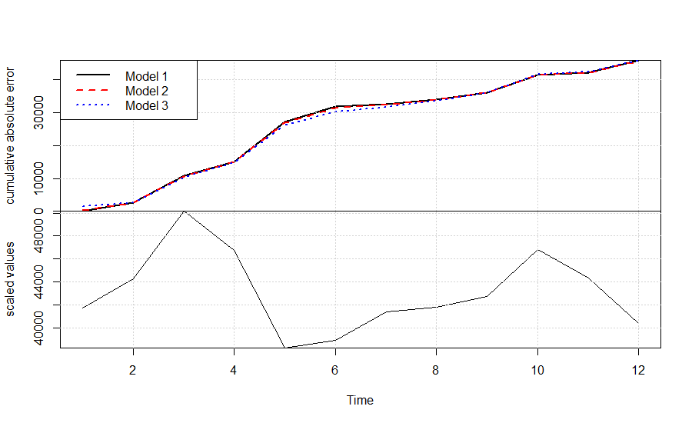
Results
FDI does not contribute in 6 of 7 G7 countries
UK Model comparison for reference (cumulative absolute error for prediction one step ahead):

Slide 7
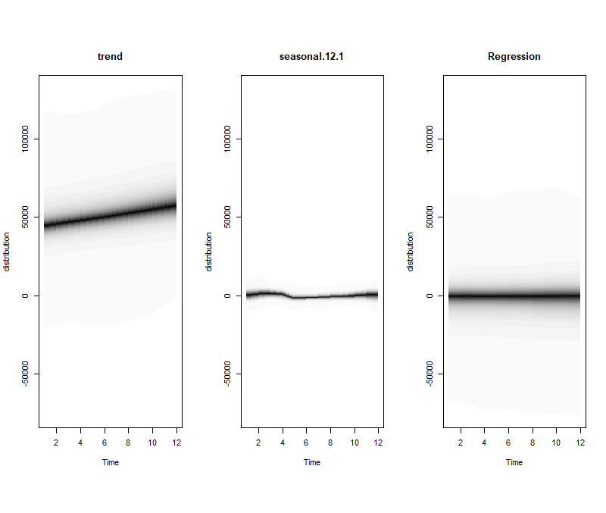
Results (cont)
Trend dominates seasonality and regressors (US model for reference)

Slide 8
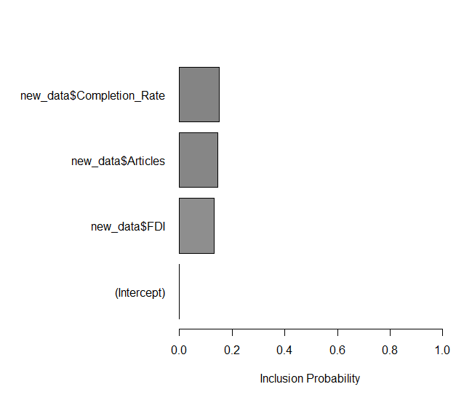
Results (cont)
Model 2 inclusion probabilities for US:

Slide 9
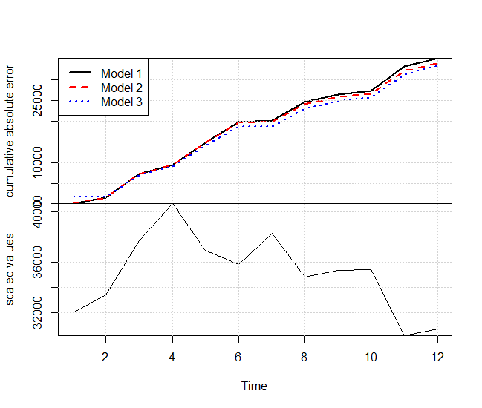
Results (cont)
Only Italy saw improvement from including predictors

Slide 10
Conclusion
FDI is not a strong predictor for GDP per capita in very high income countries
Domestic investment may be preferable in many situations if possible
May need to more carefully examine economic effects of trade deals when compared to low income countries

